Slide 1


PETTI KADAI: Empowering Women Entrepreneurs through Modern E-commerce
AAA COLLEGE OF ENGINEERING & TECHNOLOGY Kamarajar Educational Road, Amathur, Sivakasi – 626 005
TEAM NAME: PRICELESS BRAINS
Presented By:
Mr.R.SURIYAMOORTHY (Reg. No: 953721106047)
III Year - ECE, AAACET

Slide 2
Objective
The objective of PETTI KADAI is to empower women entrepreneurs by providing them with a modern e-commerce platform. Our goal is to facilitate seamless transactions while promoting quality, hygiene, and timely delivery of goods. Additionally, we aim to support women's self-employment initiatives, enabling them to showcase and sell their products effectively.

Slide 3

Abstract
PETTI KADAI is a project aimed at empowering women entrepreneurs through a modern e-commerce platform. We compress traditional and modern methods to create a user-friendly application that enables individuals, particularly women's self-help groups, to sell their products efficiently. The application focuses on delivering high-quality, hygienic goods to customers while streamlining the purchasing process. Through PETTI KADAI, we seek to provide opportunities for women to enter the business world and contribute to their economic independence.

Slide 4
Single vendor
Our project aims to empower women's self-help groups by providing a platform to sell their high-quality, hygienic goods efficiently. Acting as a mediator, our application ensures timely delivery and customer satisfaction. Group heads can oversee operations as admins, fostering independence and economic empowerment for these groups.
Inputs
Outputs
Women entrepreneur
Clients
Input 1
Output 1
Input 2
Output 2
Input 3
Output 3

Slide 5
Methodology .
02
Vendor Onboarding: Single vendors, typically women's self-help groups, register on the platform.
01
Administrative Controls: Group leaders are granted administrative privileges to manage inventory, orders, and other operational aspects
04
Product Listing: Vendors upload their products, specifying details such as quality standards and hygiene practices.
03
Payment Processing: Secure payment gateways handle transactions, providing convenience and security to customers.
05
Order Management: The platform facilitates order placement and processing, ensuring timely delivery and adherence to quality standards.
Methodology business

Slide 6
App logo

Slide 7
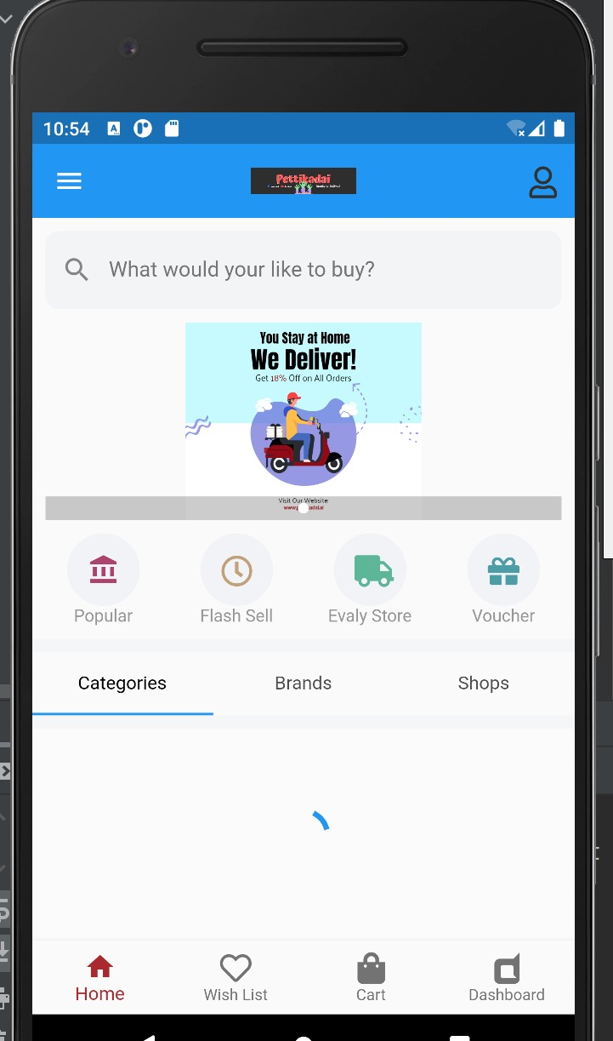
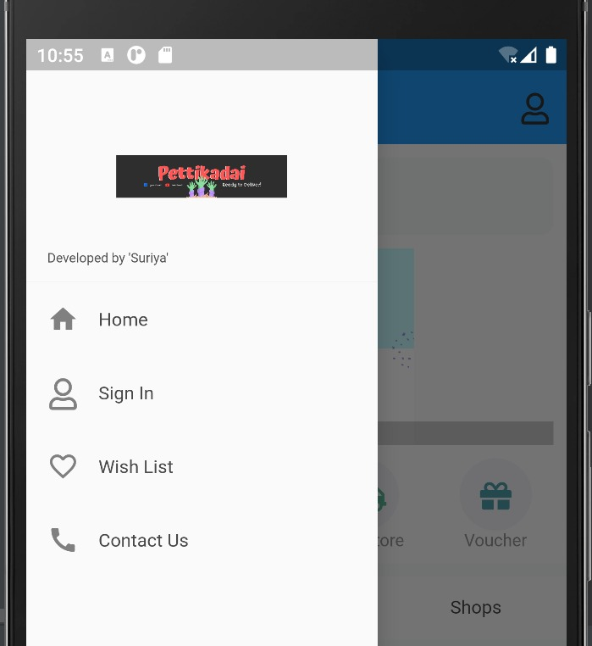


Slide 8
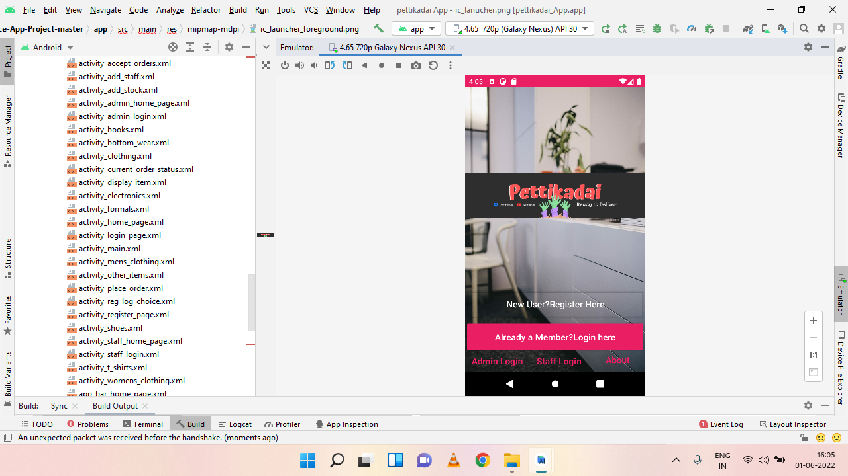

Slide 9
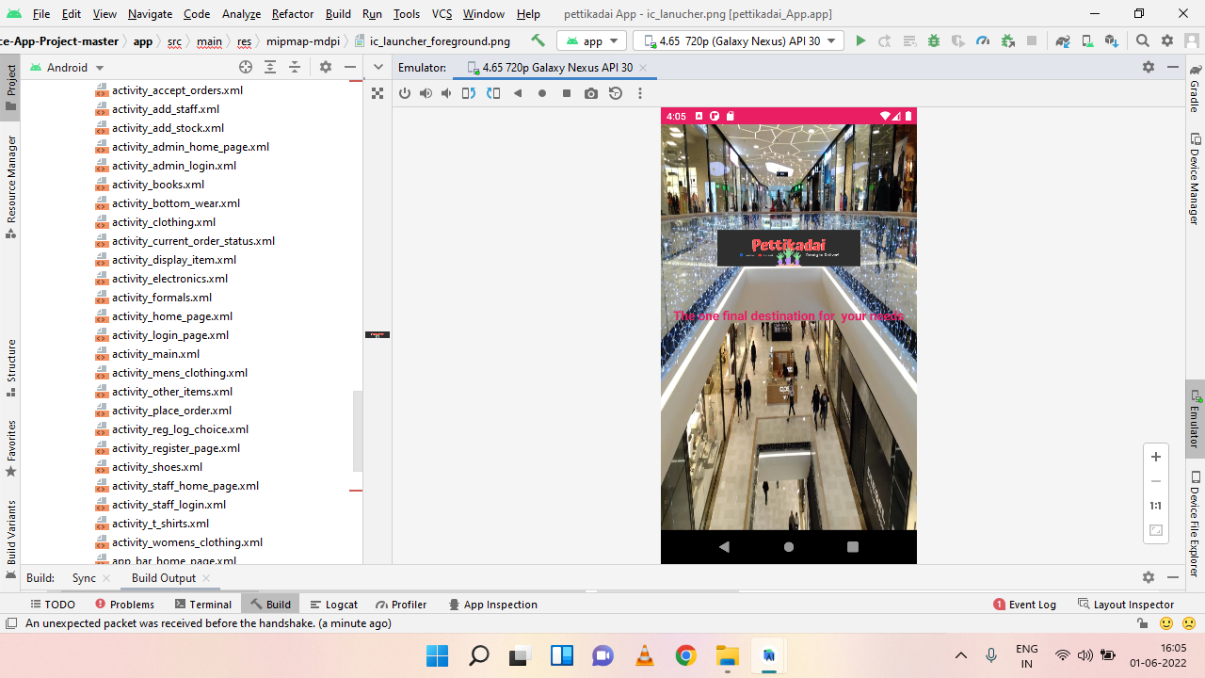

Slide 10
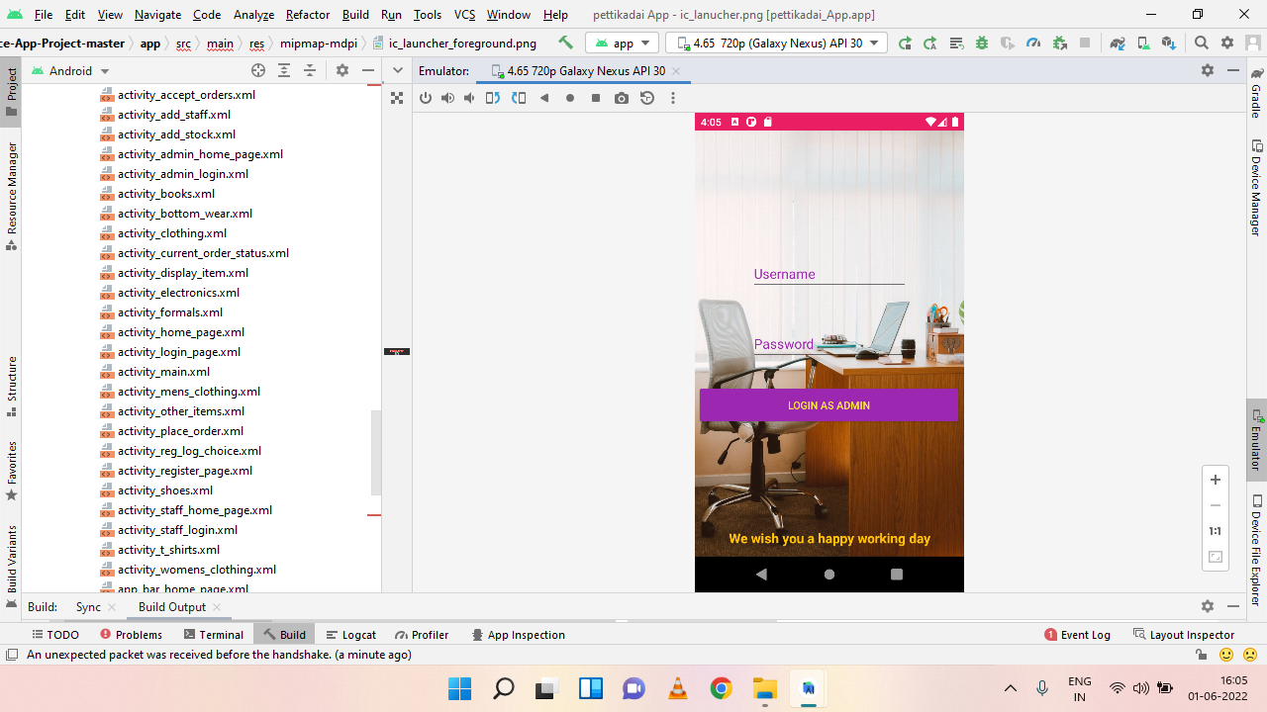

Slide 11
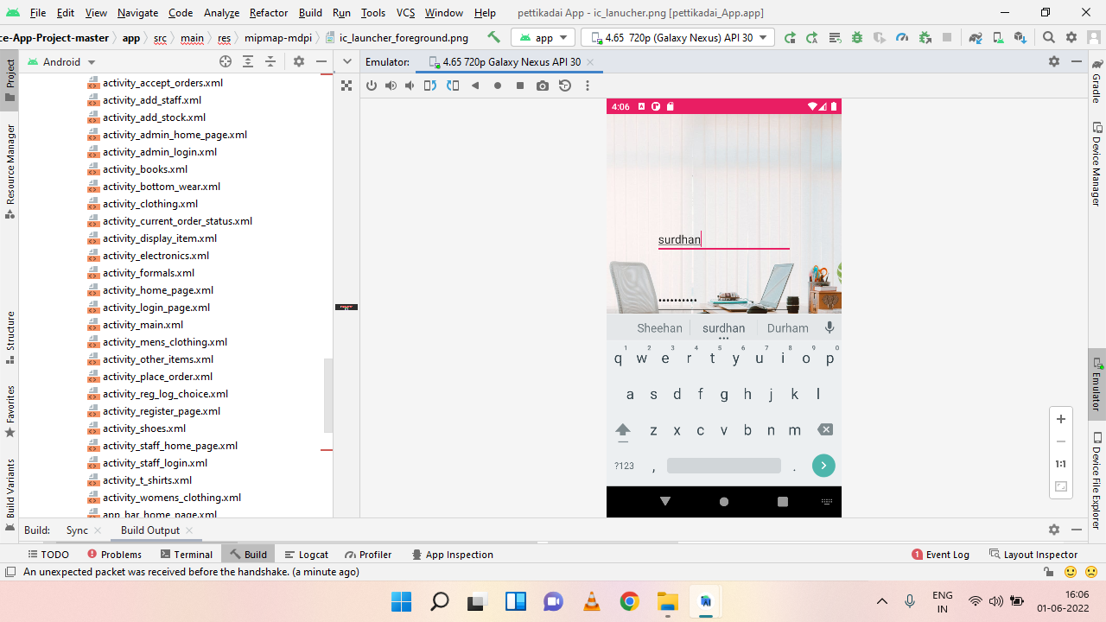

Slide 12
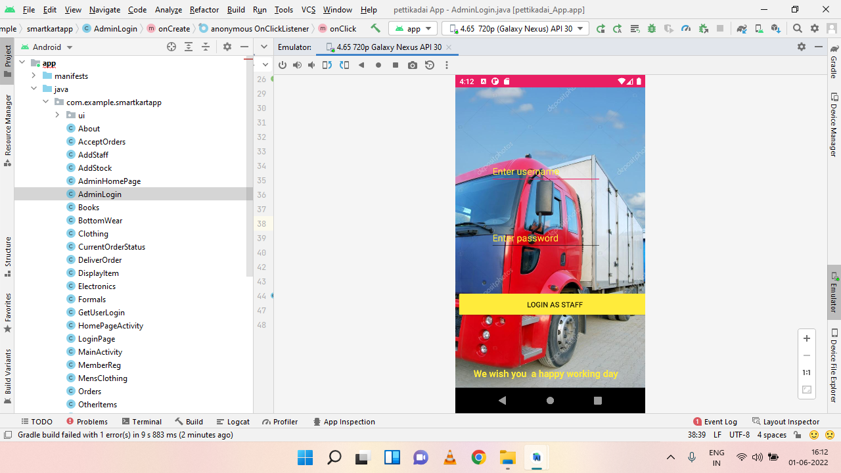

Slide 13
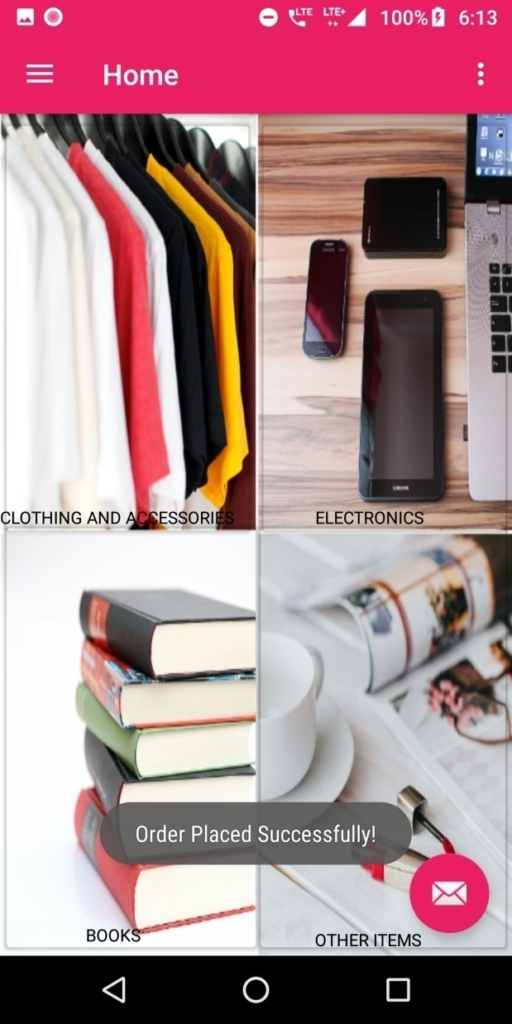
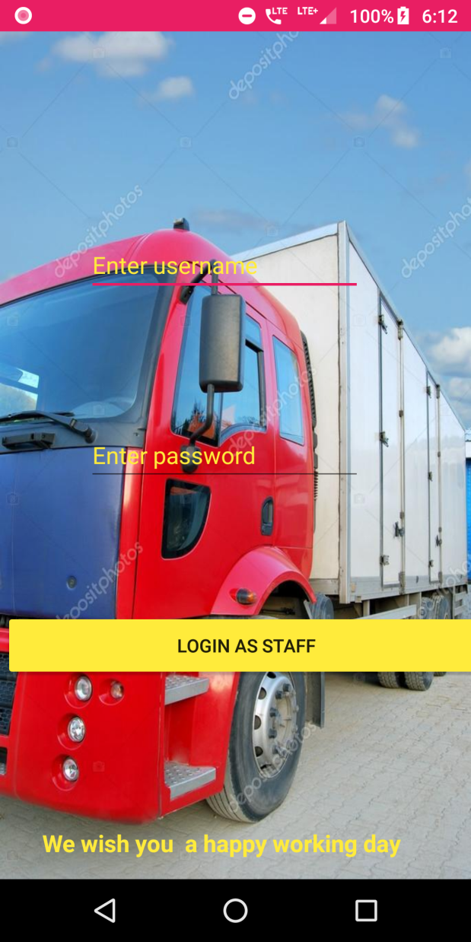

Slide 14
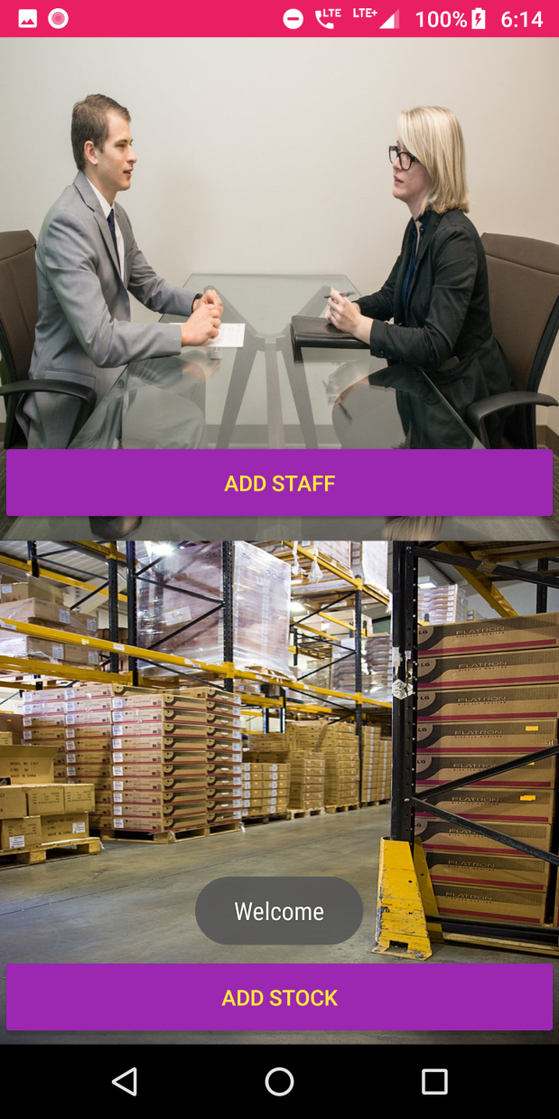
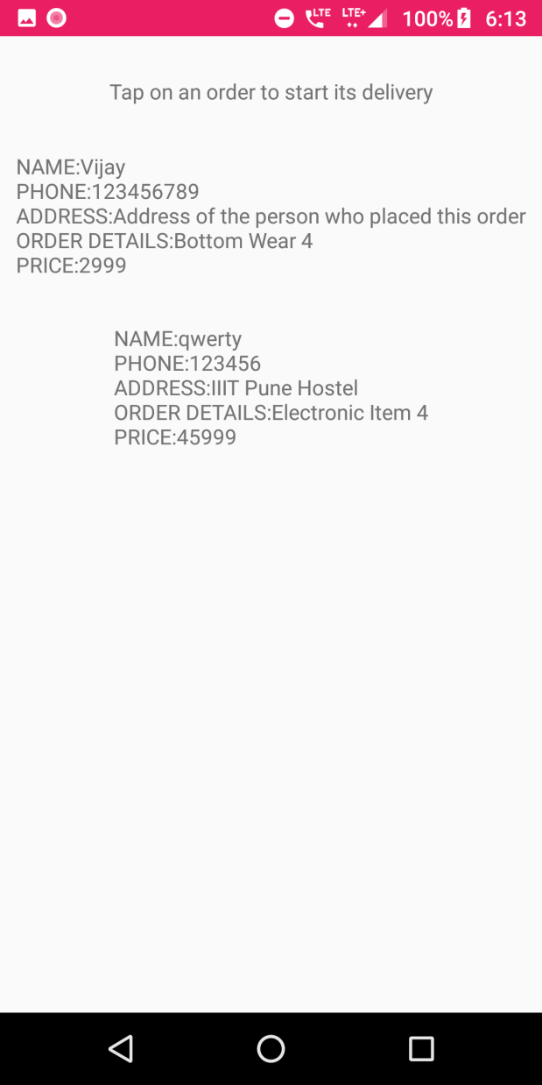

Slide 15
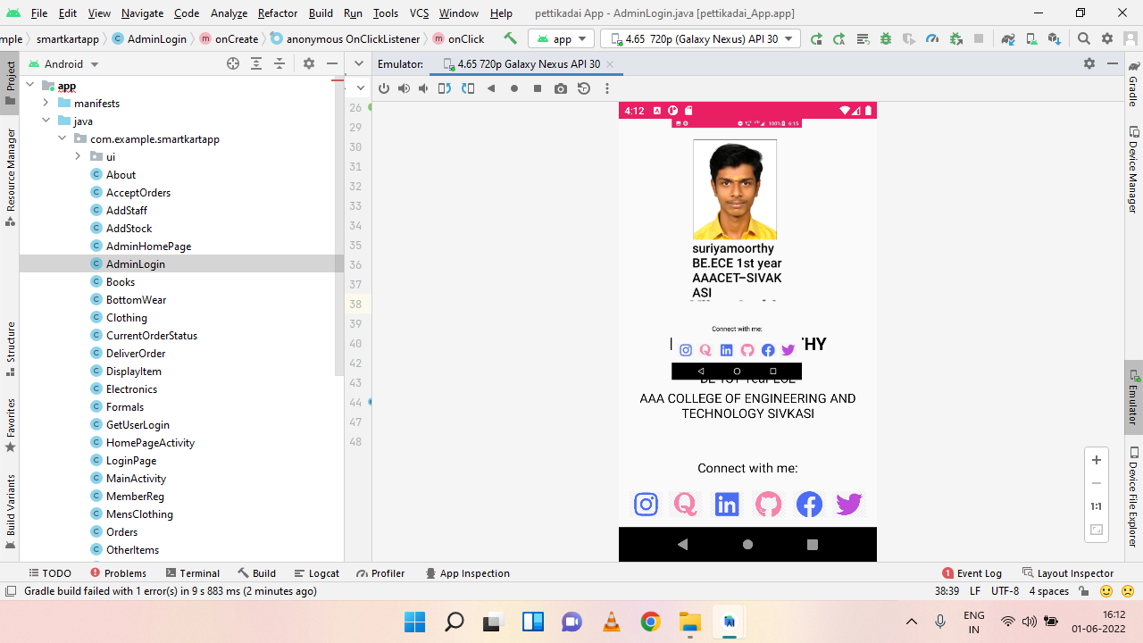

Slide 16

Network
Attractive offers

Slide 17
Challenges during development of this project
Technical Complexity:
01
Quality Control
02
User Adoption and Engagement
03
Logistical Challenges
04

Slide 18

Design

Slide 19
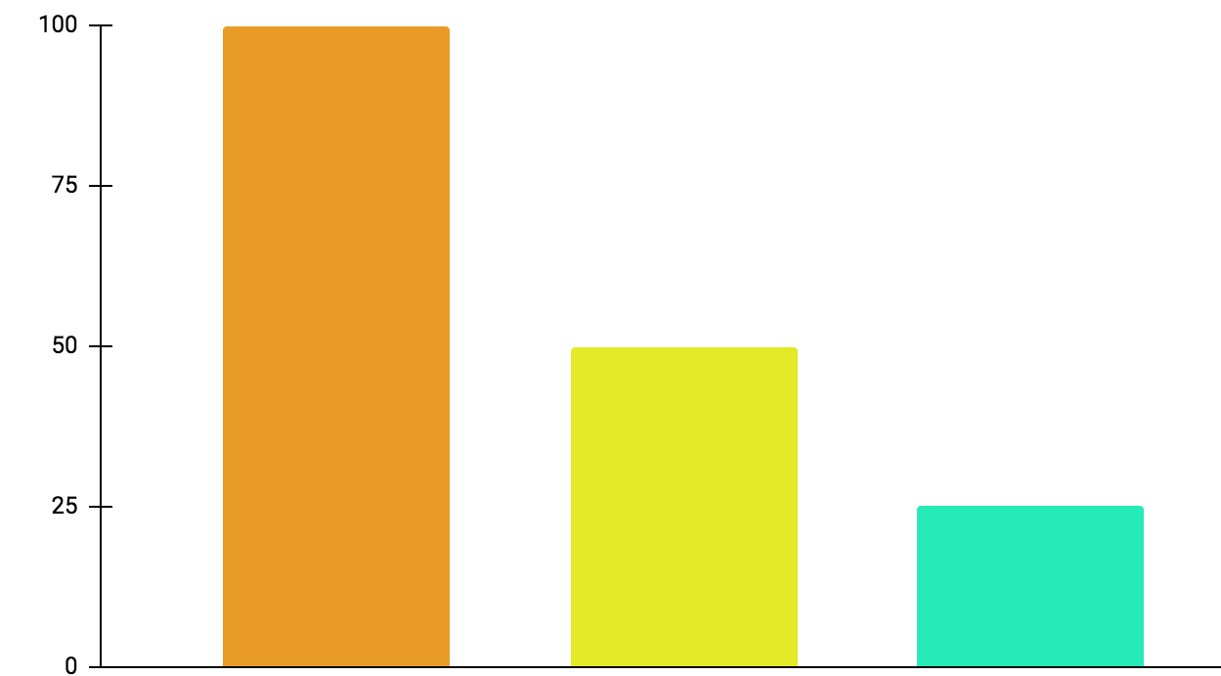
Profit in 3months
01
Profit
02
Working
03
Investment
100%
50%
25%

Slide 20
Results
Single vendors, such as women's self-help groups, successfully utilize the platform to sell their products.
Customers benefit from timely delivery, superior product quality, and hygienic goods.
The administrative features empower group leaders to manage operations efficiently.

Slide 21

Conclusion
1. PETTI KADAI holds potential to empower women entrepreneurs.
2. It addresses customer needs while promoting socio-economic empowerment.
3. Efficient operations and user-friendly features ensure platform success.
4. Continued refinement and support will sustain its impact.

Slide 22
Future frame work
01
02
03
Enhanced Analytics Integration
Social Impact Initiatives
Expanded Vendor Base
04
05
Technological Advancements
Global Expansion

Slide 23
Project link
https://drive.google.com/file/d/1KCnPL9YpfkDXUudWWSaA9tlja0zBZpso/view?usp=sharing

Slide 24
Thank you

